Slide 1
COMPREHENSIVE ECONOMIC DEVELOPMENT STRATEGY
MEETING TWO
KELECHI CHIBUIKEM

Slide 2
H
E
TODAY'S AGENDA
Welcome
Committee Expectations and Results
S.W.O.T.
Subcommittee Focus Group Sessions
Action Plan & Discussion
Questions
Adjournment
L
O
L

Slide 3
Brief Definition
A five-year strategic plan for economic development on southeast Nebraska
What is a CEDS?
What It Does
Sets out an action plan with priority projects that will move our region's economy toward a sustainable future
Who's Involved
Members of the public, stakeholders (CEDS Strategy Committee), SENDD Staff

Slide 4
Meeting Goal
To identify a set of top priority issues to address over the next five years in order for the CEDS to have the greatest positive impact on regional economic performance long-term.

Slide 5
Committee Expectations
Draft a vision statement and tagline
Engage actively in focus group sessions
Identify regional priorities
Draft an action plan

Slide 6
Vision
Proposed Plan Structure
Goals
Priorities
Action Plan

Slide 7
Some Regional Challenges

Slide 8
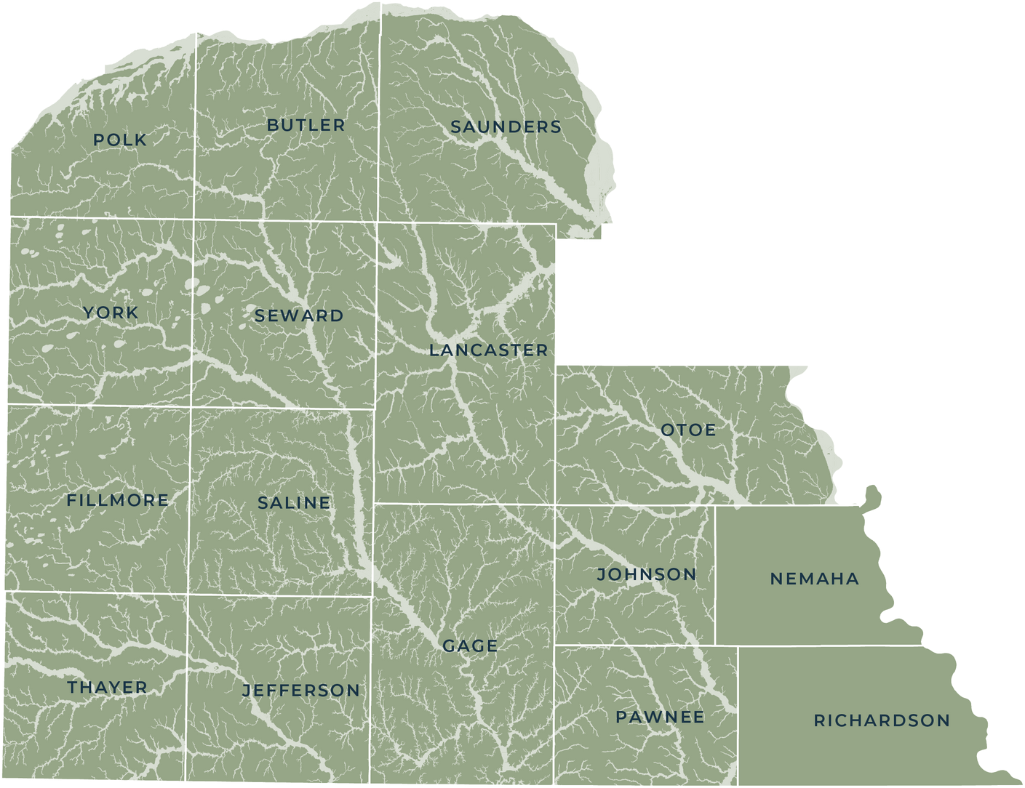
Climate Change
Flood Hazard Areas
Over 25% of the region is in the FEMA Special Flood Hazard Area
Common Regional Challenges
Continued Population Pressures
Workforce
Housing
Map shows FEMA Special Flood Hazard Areas (SFHA)

Slide 9
CEDS Strategic Direction
Vision and Goals - Where do we want to be in 2040?

Slide 10
Draft a Vision Statement
Cultivating creativity, diversity, and innovation to build a strong and resilient economy.
Example:
Draft a Creative Tagline
Example:
Building together

Slide 11
Natural Systems
Focuses on the natural environment, natural resources, and ecosystems
Built
Systems
Focuses on the built environment, and infrastructure
Focuses on community , historical, and societal spaces within the region
Community Systems

Slide 12
Regional Collaboration and Commitment
To create a platform for local and regional organizations to devise and implement economic development policies and projects, as well as to promote economic resiliency.
Community Systems
Goals
Economy and Housing
To promote a sustainable regional economy comprised of a broad range of businesses, diverse employment opportunities, improved education standards, and an adequate supply of ownership and rental housing that is safe, healthy, and attainable for people with a variety of needs and income levels.

Slide 13
Capital Facilities and Infrastructure
To expand dependable, resilient, and efficient infrastructure that is centrally located, equitably distributed, and meets regional needs such as cleaner energy, waste reduction, clean air and water, broadband networks, and multi-modal transportation.
Built Systems
Goals
Built Resources
To preserve and enhance the distinct character of the region's built environment including traditional development patterns, cultural and historical resources.

Slide 14
Natural Resources
Natural
Systems
Goals
To conserve, preserve, protect, and restore the region’s natural resources including drinking water, surface and groundwater, and wetlands; plant and animal habitats; agricultural resources and recreational resources.

Slide 15
Comments and Questions

Slide 16
Framing the Future
SWOT and identifying priorities

Slide 17
CEDS COMMITTEE MEETING
SWOT ANALYSIS
S
W
O
T
STRENGTHS
WEAKNESSES
OPPORTUNITIES
THREATS
CEDS 2021

Slide 18
FOCUS GROUPS
INTERNAL FACTORS
EXTERNAL FACTORS
S
W
0
T

Slide 19
Equitable Growth
Workforce Development
Business Development
Housing
Education Sector Development
Focus Groups
Connectivity and Resilience
Infrastructure
Tourism
Disaster Preparedness

Slide 20
Equitable Growth
Group Member List
Connectivity and Resilience

Slide 21
Exercise Outline
Brainstorm internal factors
Brainstorm external factors
Discussion of priorities
Identify top priorities to share with full group

Slide 27
SNEAK PEAK INTO SURVEY RESULTS

Slide 28
60%
Which aspects of the region's general economy are most important to address?
40%
20%
0%
Marketing
Skilled Workforce
Entrepreneurship
Economic Vision
Population Growth
Affordable Housing
Business Destination
Improved Infrastructure

Slide 29
60%
Which aspects of the region's physical infrastructure are most important to address?
40%
20%
0%
Rail Access
Bike Trails
Airports
Broadband
Water
Road Quality
Public Transit
Aging Infrastructure

Slide 30
60%
Which economic development conditions are most important for southeast Nebraska
40%
20%
0%
Start-ups
Tourism
Higher Wages
Business Support
Housing Programs
Infrastructure Growth
Workforce Initiatives
Economic Opportunity
Recruiting New Business

Slide 31
50%
40%
30%
Pursuing a targeted approach
20%
10%
0%
Tourism
Retail
Education
Housing
Small Business
Agriculture
Manufacturing
Healthcare
Entrepreneurship
Information Technology

Slide 32
Please be concise–allow others to speak, and do not interrupt others
Please be respectful–direct comments to issues, not individuals or other participants
Please be constructive–offer ideas that can help build a more resilient region for southeast Nebraska
Focus Group Ground Rules

Slide 33
Regional Priorities: Equitable Growth

Slide 34
Regional Priorities: Connectivity

Slide 35
Regional Priorities: ALL (7)

Slide 36
How well do the priorities meet the following criteria: (Take-home assignment, maybe*)
Evaluating Regional Priorities
1.Which are most achievable in a 5-year timeframe?
2.Which priority has the highest impact?
3.Which best promotes economic resilience?

Slide 37
Developing the CEDS Action Plan
How do we get there?

Slide 38
Goal: Support Regional Broadband Expansion
Outcomes
A broadband mapping initiative was created to access the quality of broadband services in the region
Past CEDS Project and Initiatives
Census tracts and counties are provided with solutions to access more funds through this data
Gaps and opportunities for broadband expansion through partnerships and collaborations are identified

Slide 39
Initiatives
What makes up a CEDS Action Plan?
No definite end date
Clear purpose and particular approach
Individual steps to be determined
Projects
SMART: Specific, Measurable, Achievable, Realistic, Timeframe
Definitive start and end
Deliverables; Final report or other tangible results
Partnerships

Slide 40
Planning Efforts
What does EDA Fund?
Capital Investment in Infrastructure
Technical Assistance

Slide 41
Themes to consider
Social and Economic Justice
Climate Change
Economic Resilience
Global and Local Pandemic

Slide 42
INITIATIVE :
Subcommittee Name:
Potential partners:
Deliverables:
Project Name:
Timeline:
Goal:
Measures of Success:

Slide 43
Questions and Assignment

Slide 44
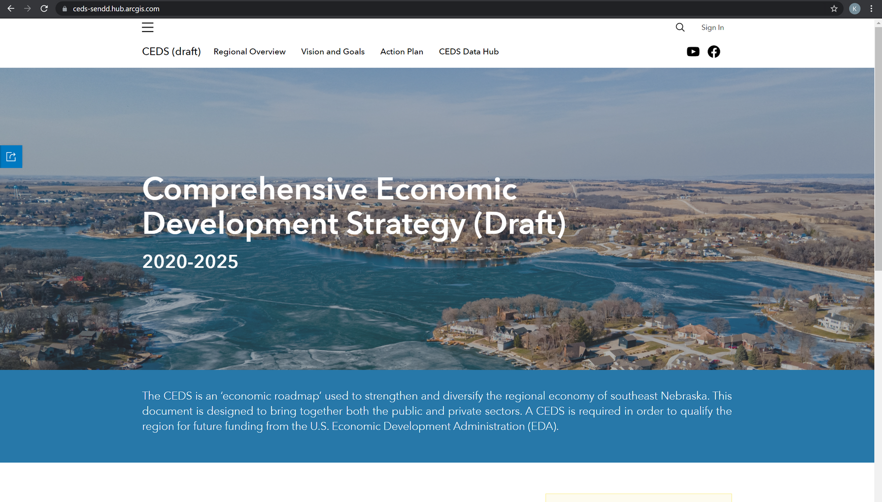
Website Preview
https://ceds-sendd.hub.arcgis.com/

Slide 45
Thank you!

